Slide 1

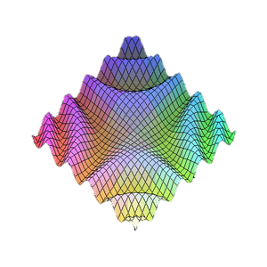
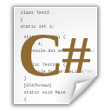

Multidimensional Arrays
http://csharpfundamentals.telerik.com
Processing Matrices and Multidimensional Tables
Svetlin Nakov
Technical Trainer
www.nakov.com
Telerik Software Academy
academy.telerik.com

Slide 2


Table of Contents
Matrices and Multidimensional Arrays
Declaring
Usage
Jagged Arrays
Declaring
Usage
The Array Class
Sorting
Binary Search

Slide 3
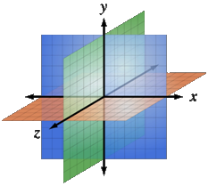
Multidimensional Arrays
Using Array of Arrays, Matrices and Cubes

Slide 4
What is Multidimensional Array?
Multidimensional arrays have more than one dimension (2, 3, …)
The most important multidimensional arrays are the 2-dimensional
Known as matrices or tables
Example of matrix of integers with 2 rows and 4 columns:
0 | 1 | 2 | 3
5 | 0 | -2 | 4
5 | 6 | 7 | 8
0
1

Slide 5
Declaring and Creating Multidimensional Arrays
Declaring multidimensional arrays:
Creating a multidimensional array
Use new keyword
Must specify the size of each dimension
int[,] intMatrix;
float[,] floatMatrix;
string[,,] strCube;
int[,] intMatrix = new int[3, 4];
float[,] floatMatrix = new float[8, 2];
string[,,] stringCube = new string[5, 5, 5];

Slide 6
Initializing Multidimensional Arrays with Values
Creating and initializing with values multidimensional array:
Matrices are represented by a list of rows
Rows consist of list of values
The first dimension comes first, the second comes next (inside the first)
int[,] matrix =
{
{1, 2, 3, 4}, // row 0 values
{5, 6, 7, 8}, // row 1 values
}; // The matrix size is 2 x 4 (2 rows, 4 cols)

Slide 7
Accessing The Elements of Multidimensional Arrays
Accessing N-dimensional array element:
Getting element value example:
Setting element value example:
nDimensionalArray[index₁, … , index_{n}]
int[,] array = {{1, 2}, {3, 4}}
int element11 = array[1, 1]; // element11 = 4
Number of rows
int[,] array = new int[3, 4];
for (int row=0; row<array.GetLength(0); row++)
for (int col=0; col<array.GetLength(1); col++)
array[row, col] = row + col;
Number of columns

Slide 8
Reading a Matrix – Example
Reading a matrix from the console
int rows = int.Parse(Console.ReadLine());
int columns = int.Parse(Console.ReadLine());
int[,] matrix = new int[rows, columns];
String inputNumber;
for (int row=0; row<rows; row++)
{
for (int column=0; column<cols; column++)
{
Console.Write("matrix[{0},{1}] = ", row, column);
inputNumber = Console.ReadLine();
matrix[row, column] = int.Parse(inputNumber);
}
}

Slide 9
Printing Matrix – Example
Printing a matrix on the console:
for (int row=0; row<matrix.GetLength(0); row++)
{
for (int col=0; col<matrix.GetLength(1); col++)
{
Console.Write("{0} ", matrix[row, col]);
}
Console.WriteLine();
}

Slide 10

Reading and Printing Matrices
Live Demo

Slide 11
Maximal Platform – Example
Finding a 2 x 2 platform in a matrix with a maximal sum of its elements
int[,] matrix = {
{7, 1, 3, 3, 2, 1},
{1, 3, 9, 8, 5, 6},
{4, 6, 7, 9, 1, 0} };
int bestSum = int.MinValue;
for (int row=0; row<matrix.GetLength(0)-1; row++)
for (int col=0; col<matrix.GetLength(1)-1; col++)
{
int sum = matrix[row, col] + matrix[row, col+1] + matrix[row+1, col] + matrix[row+1, col+1];
if (sum > bestSum)
bestSum = sum;
}

Slide 12

Maximal Platform
Live Demo

Slide 13

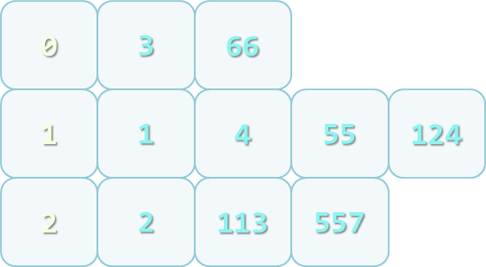
Jagged Arrays
What are Jagged Arrays and How to Use Them?

Slide 14
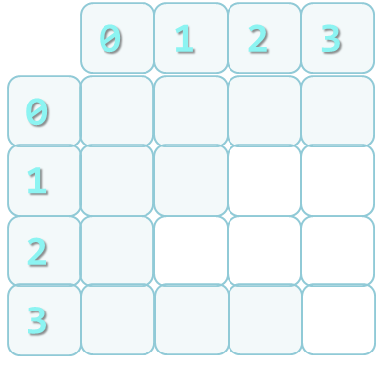
Jagged Arrays
Jagged arrays are like multidimensional arrays
But each dimension has different size
A jagged array is array of arrays
Each of the arrays has different length
How to create jagged array?
int[][] jagged = new int[3][];
jagged[0] = new int[3];
jagged[1] = new int[2];
jagged[2] = new int[5];

Slide 15
Initialization of Jagged Arrays
When creating jagged arrays
Initially the array is created of null arrays
Need to initialize each of them
int[][] jagged=new int[n][];
for (int i=0; i<n; i++) {
jagged[i] = new int[i]; }

Slide 16


Jagged Arrays
Live Demo

Slide 17
Example of Jagged Arrays
Check a set of numbers and group them by their remainder when dividing to 3 (0, 1 and 2)
Example: 0, 1, 4, 113, 55, 3, 1, 2, 66, 557, 124, 2
First we need to count the numbers
Done with a iteration
Make jagged array with appropriate sizes
Each number is added into its jagged array

Slide 18
Example of Jagged Arrays
int[] numbers = {0,1,4,113,55,3,1,2,66,557,124,2};
int[] sizes = new int[3];
int[] offsets = new int[3];
foreach (var number in numbers)
{
int remainder = number % 3;
sizes[remainder]++;
}
int[][] numbersByRemainder = new int[3][] {
new int[sizes[0]], new int[sizes[1]],
new int[sizes[2]] };
foreach (var number in numbers)
{
int remainder = number % 3;
int index = offsets[remainder];
numbersByRemainder[remainder][index] = number;
offsets[remainder]++;
}

Slide 19
Remainders of 3
Live Demo

Slide 20
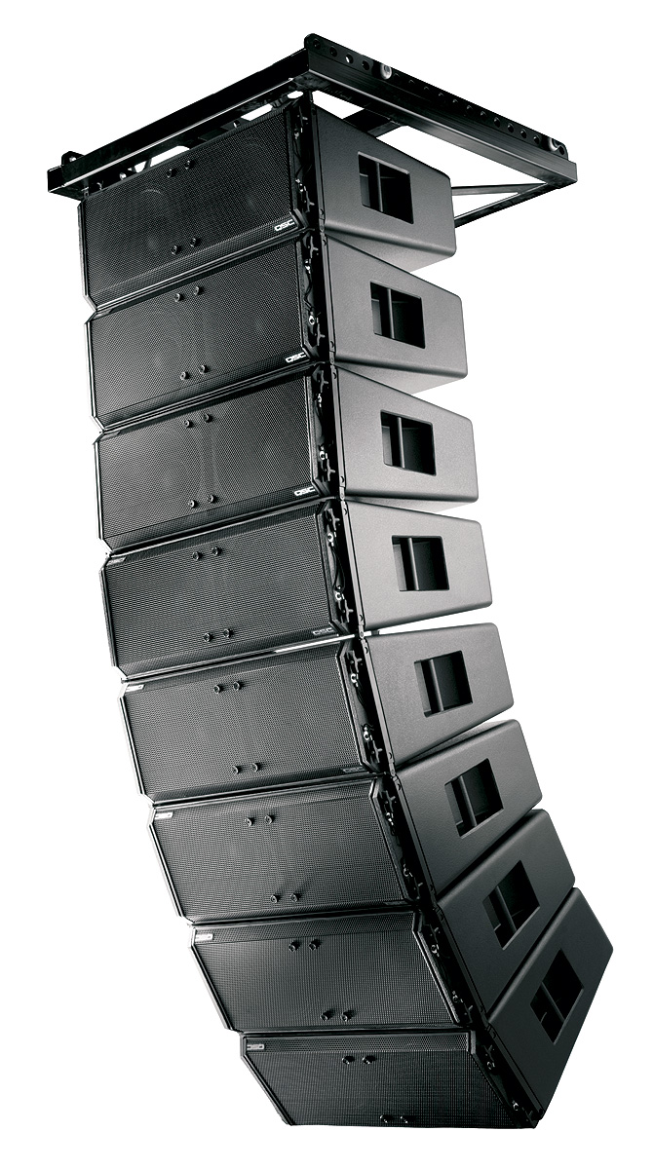
Array Class
What Can We Use?

Slide 21

The Array Class
The System.Array class
Parent of all arrays
All arrays inherit from it
All arrays have the same:
Basic functionality
Basic properties
E.g. Length property

Slide 22
Methods of Array
Important methods and properties of System.Array
Rank – number of dimensions
Length – number of all elements through all dimensions
GetLength(index) – returns the number of elements in the specified dimension
Dimensions are numbered from 0

Slide 23
Methods of Array (2)
GetEnumerator() – returns IEnumerator for the array elements
BinarySearch(…) – searches for a given element into a sorted array (uses binary search)
IndexOf(…) – searches for a given element and returns the index of the first occurrence (if any)
LastIndexOf(…) – searches for a given element and returns the last occurrence index
Copy(src, dest, len) – copies array elements; has many overloads

Slide 24
Methods of Array (3)
Reverse(…) – inverts the arrays elements upside down
Clear(…) – assigns value 0 (null) for each elements
CreateInstance(…) – creates an array
Accepts as parameters the number of dimensions, start index and number of elements
Implements ICloneable, IList, ICollection and IEnumerable interfaces

Slide 25

Sorting Arrays

Slide 26
Sorting Arrays
Sorting in .NET is usually done with System.Array.Sort()
Sort(Array) – sorts array elements
Elements should implement IComparable
Sort(Array, IComparer) – sorts array elements by given external IComparer
Sort(Array, Comparison<T>) – sorts array elements by given comparison operation
Can be used with lambda expression

Slide 27

Sorting Arrays – Example
static void Main()
{
String[] beers = {"Zagorka", "Ariana",
"Shumensko","Astika", "Kamenitza", "Bolqrka",
"Amstel"};
Console.WriteLine("Unsorted: {0}",
String.Join(", ", beers));
// Elements of beers array are of String type,
// which implement IComparable
Array.Sort(beers);
Console.WriteLine("Sorted: {0}",
String.Join(", ", beers));
// Result: Sorted: Amstel, Ariana, Astika,
// Bolyarka, Kamenitza, Shumensko, Zagorka
}

Slide 28
Sorting with IComparer<T> and Lambda Expressions – Example
class Student
{
…
}
public class StudentAgeComparer : IComparer<Student>
{
public int Compare(Student firstStudent, Student secondStudent)
{
return firstStudent.Age.CompareTo(secondStudent.Age);
}
}
…
Array.Sort(students, new StudentAgeComparer());
…
Array.Sort(students, (x, y) => x.Name.CompareTo(y.Name));

Slide 29

Sorting with IComparer<T> and Lambda Expressions
Live Demo

Slide 30

Binary Search

Slide 31
Binary Search
Binary search is a fast method for searching for an element in a sorted array
Has guaranteed running time of O(log(n)) for searching among arrays of with n elements
Implemented in the Array.BinarySearch( Array, object) method
Returns the index of the found object or a negative number when not found

Slide 32

Binary Search (2)
All requirements of the Sort() method are applicable for BinarySearch()
Either all elements should implement IComparable<T> or instance of IComparer<T> should be passed

Slide 33
Binary Search – Example
static void Main()
{
String[] beers = {"Zagorka", "Ariana",
"Shumensko","Astika", "Kamenitza", "Bolqrka",
"Amstel"};
Array.Sort(beers);
string target = "Astika";
int index = Array.BinarySearch(beers, target);
Console.WriteLine("{0} is found at index {1}.",
target, index);
// Result: Astika is found at index 2.
target = "Heineken";
index = Array.BinarySearch(beers, target);
Console.WriteLine("{0} is not found (index={1}).",
target, index);
// Result: Mastika is not found (index=-5).
}

Slide 34
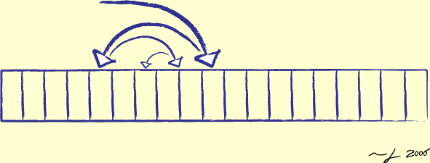
Binary Search
Live Demo

Slide 35

Working with Arrays
Best Practices

Slide 36
Advices for Working with Arrays
When given method returns an array and should return an empty array, return an array with 0 elements, instead of null
Arrays are passed by reference
To be sure that given method will not change the passed array, pass a copy of it
Clone() returns shallow copy of the array
You should implement your own deep clone when working with reference types

Slide 37





Arrays
http://csharpfundamentals.telerik.com

Slide 38
Exercises
Write a program that fills and prints a matrix of size (n, n) as shown below: (examples for n = 4)
1 | 5 | 9 | 13
2 | 6 | 10 | 14
3 | 7 | 11 | 15
4 | 8 | 12 | 16
1 | 8 | 9 | 16
2 | 7 | 10 | 15
3 | 6 | 11 | 14
4 | 5 | 12 | 13
a)
b)
7 | 11 | 14 | 16
4 | 8 | 12 | 15
2 | 5 | 9 | 13
1 | 3 | 6 | 10
1 | 12 | 11 | 10
2 | 13 | 16 | 9
3 | 14 | 15 | 8
4 | 5 | 6 | 7
c)
d) *

Slide 39
Exercises (2)
Write a program that reads a rectangular matrix of size N x M and finds in it the square 3 x 3 that has maximal sum of its elements.
Denna kan vi hoppa över… We are given a matrix of strings of size N x M. Sequences in the matrix we define as sets of several neighbor elements located on the same line, column or diagonal. Write a program that finds the longest sequence of equal strings in the matrix. Example:
ha | fifi | ho | hi
fo | ha | hi | xx
xxx | ho | ha | xx
s | qq | s
pp | pp | s
pp | qq | s
ha, ha, ha
s, s, s

Slide 40
Exercises (3)
Write a program, that reads from the console an array of N integers and an integer K, sorts the array and using the method Array.BinSearch() finds the largest number in the array which is ≤ K.
You are given an array of strings. Write a method that sorts the array by the length of its elements (the number of characters composing them).
* Write a class Matrix, to holds a matrix of integers. Overload the operators for adding, subtracting and multiplying of matrices, indexer for accessing the matrix content and ToString().

Slide 41
Exercises (4)
* Write a program that finds the largest area of equal neighbor elements in a rectangular matrix and prints its size. Example:
Hint: you can use the algorithm "Depth-first search" or "Breadth-first search" (find them in Wikipedia).
1 | 3 | 2 | 2 | 2 | 4
3 | 3 | 3 | 2 | 4 | 4
4 | 3 | 1 | 2 | 3 | 3
4 | 3 | 1 | 3 | 3 | 1
4 | 3 | 3 | 3 | 1 | 1
13

Slide 42



Free Trainings @ Telerik Academy
“C# Programming @ Telerik Academy
csharpfundamentals.telerik.com
Telerik Software Academy
academy.telerik.com
Telerik Academy @ Facebook
facebook.com/TelerikAcademy
Telerik Software Academy Forums
forums.academy.telerik.com

